Slide 1

Your Organization Logo Goes Here
Paper No: 25PESGM2820
Advanced Semi-Supervised Learning With Uncertainty Estimation for Phase Identification in Distribution Systems
Kundan Kumar, Kumar Utkarsh, Jiyu Wang, Harsha Vardhana Padullaparti
National Renewable Energy Laboratory
{Kundan.Kumar, Utkarsh.Kumar, Jiyu.Wang, HarshaVardhana.Padullaparti}@nrel.gov

Slide 2
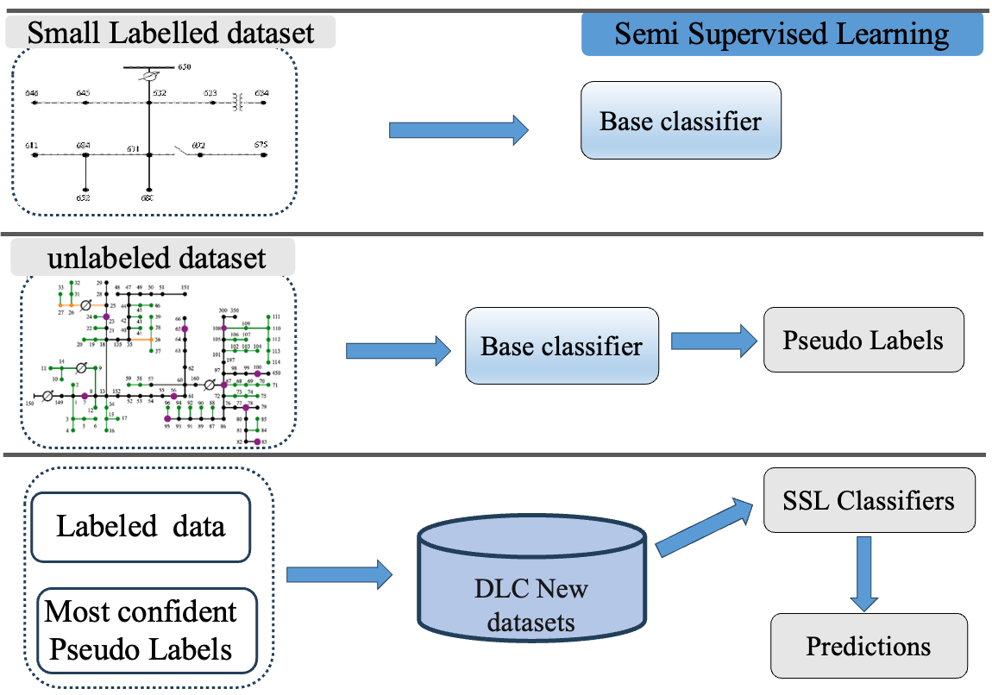
Why Phase Identification Needs a New Approach ?
Problem: Utilities don’t know which phase customers are connected to — this affects voltage regulation, DER integration, and fault localization.
Challenge: Ground truth phase data is scarce, unreliable, and costly to collect.
Supervised learning ML methods need lots of labeled data – often unavailable or unreliable.
Motivation: How do we scale phase identification without needing tons of labeled data?
Fig. 1: Illustration of semi-supervised techniques

Slide 3
What is Semi-Supervised Learning (SSL) ?
SSL uses a small amount of labeled data + a large pool of unlabeled data to train better models.
What We Did: Hybrid SSL + BNN Framework
SSL Framework
In real-world grid data, most phase labels are missing.
SSL learns from the small labeled set and improves by using patterns from the large unlabeled set.
This helps models scale without needing manual labeling.
Self-training with ensemble MLP classifiers for pseudo-labeling.
Label spreading to propagate labels through data similarity
Bayesian Neural Networks (BNNs) to model prediction uncertainty.
Designed custom BNN with epistemic and aleatoric uncertainty estimation.
Evaluated model across varying percentages of labeled data (5% to 80%).

Slide 4
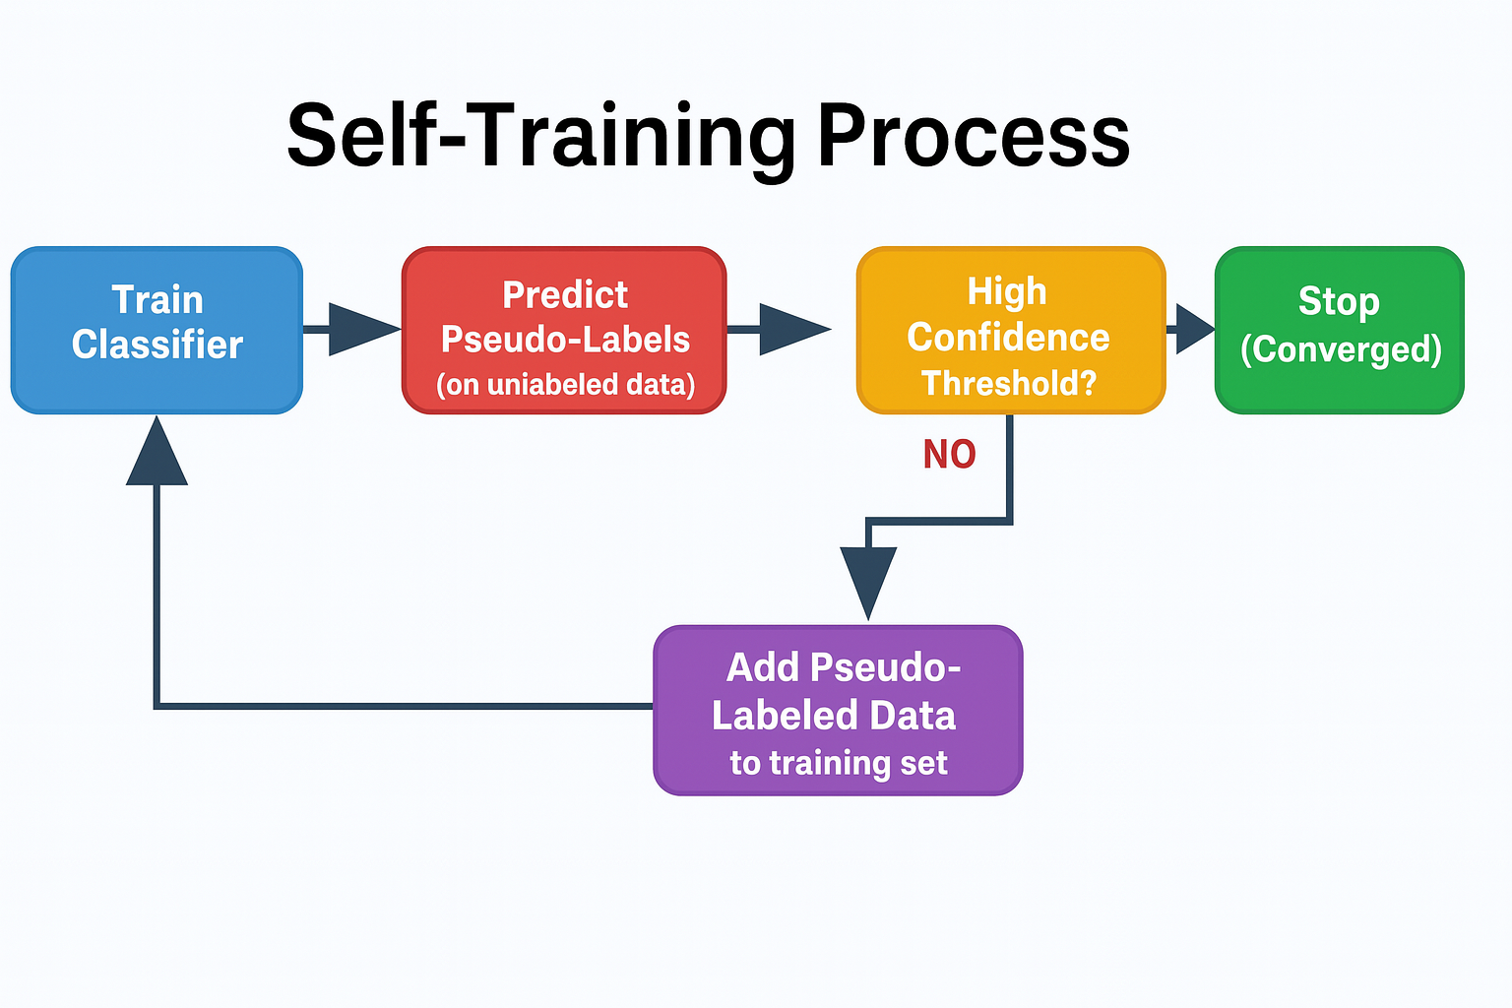
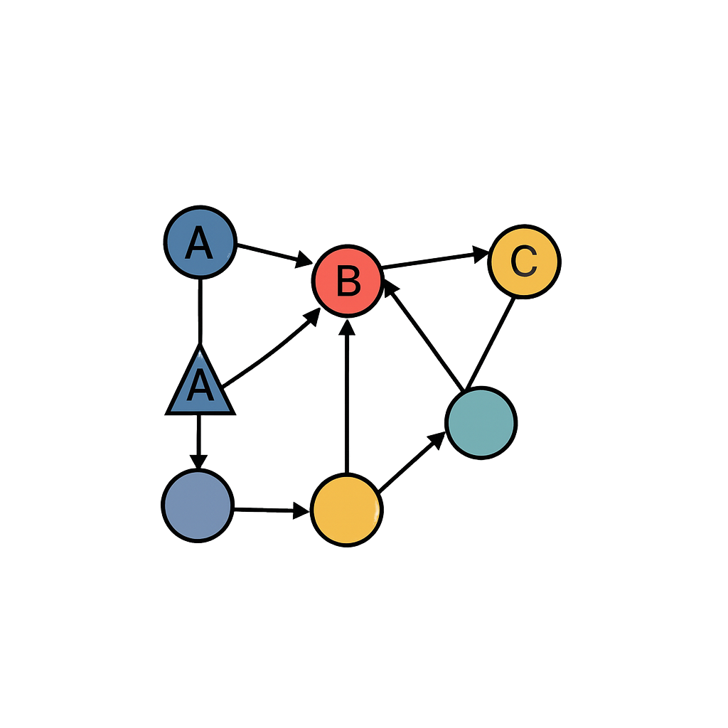
What are SSL Techniques used ?
Self-Training
Label Spreading
K-NN graph
Label Spreading Process
Use an ensemble of MLPs.
Add high-confidence pseudo-labels (probability ) to labeled set.
Labels spread on a graph based on feature similarity
Build a kNN graph of the data points.
Spread labels across nearby (similar) nodes.
Captures structure in the data.

Slide 5
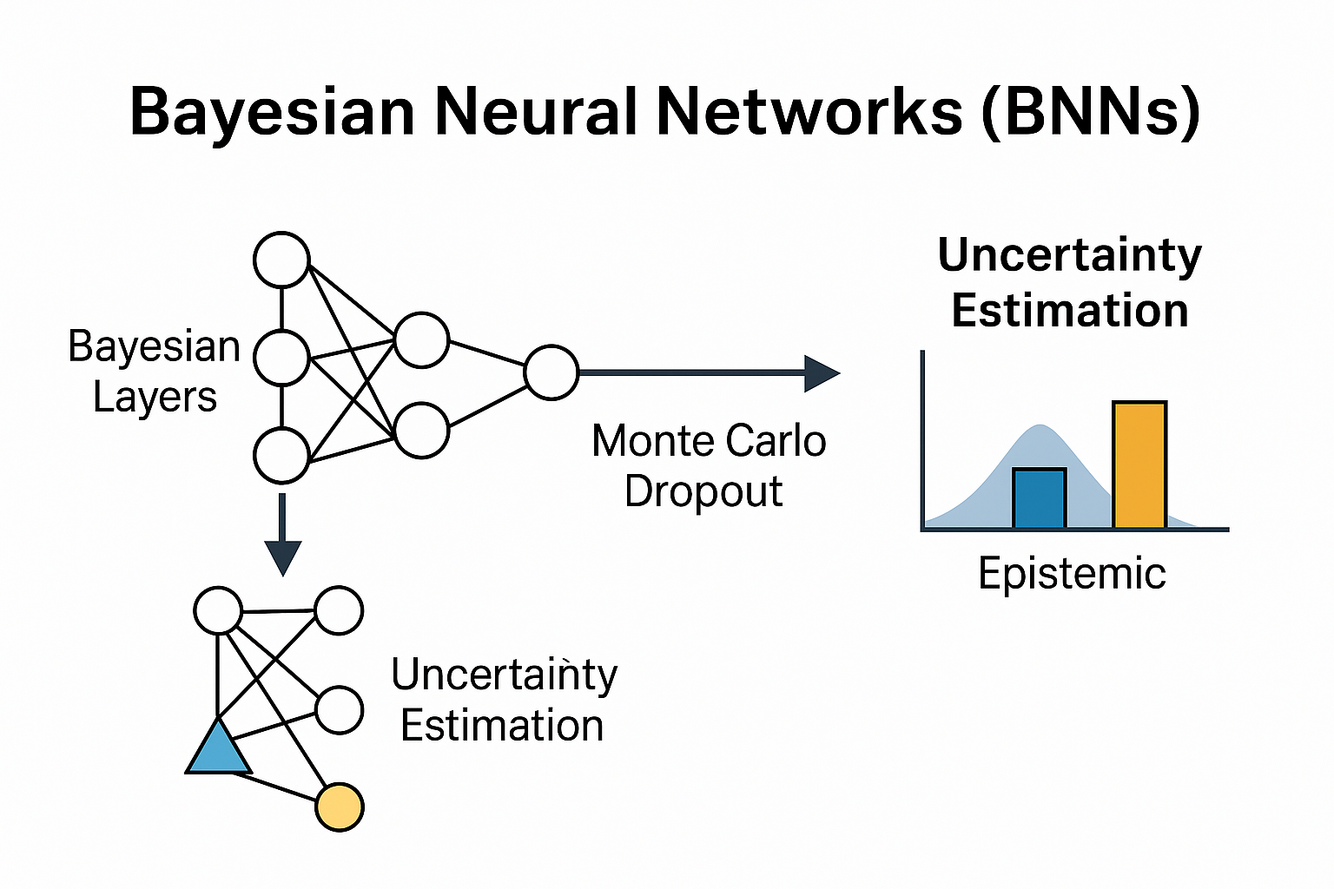
Bayesian Neural Networks (BNNs)
Neural Network (NNs) with probability distributions over weights
Uncertainty Estimation ?
In smart grids, wrong predictions can cause instability. So, we need to know not just what the model predicts — but how confident it is.
Aleatoric Uncertainty
Comes from data noise.
Can't be reduced even with more data.
Epistemic Uncertainty
Comes from lack of knowledge or data.
Can be reduced by giving the model more examples.
Unlike standard NNs, BNNs assume each weight is not fixed but comes from a distribution.
This gives confidence in every prediction.
Handles uncertainty, robust with little data.
BNNs help quantify both, giving utilities a “confidence score” along with each phase prediction.

Slide 6
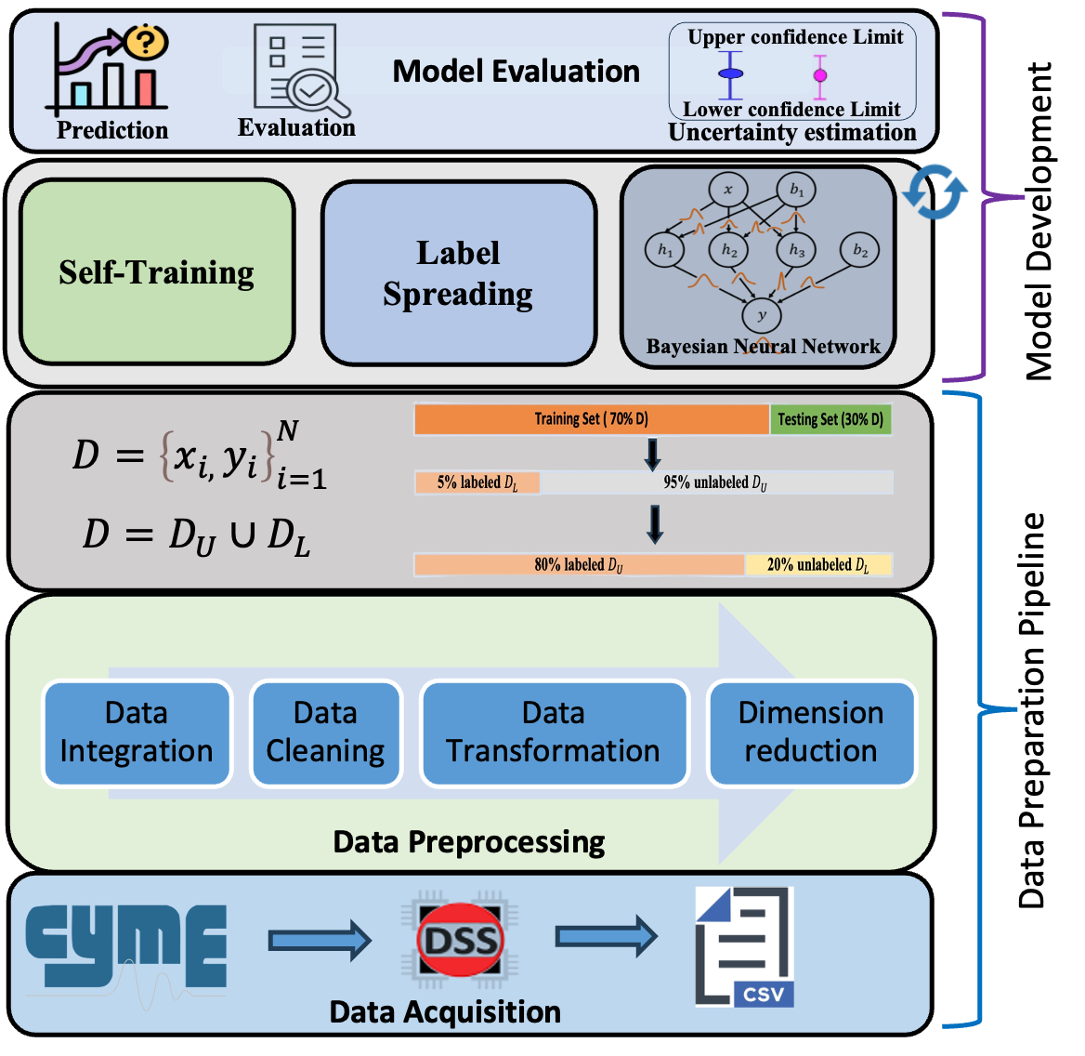
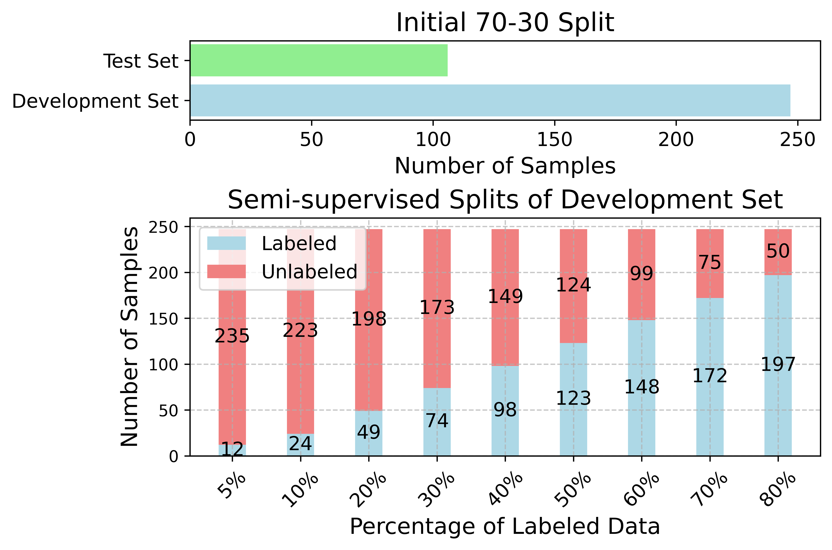
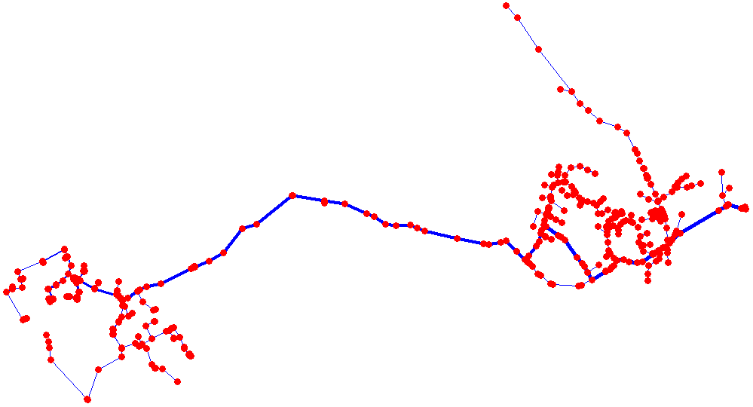
How We Did It: Data, Training & Results
Labeled + Unlabeled Data
Feature Extraction
SSL Framework
Prediction + Uncertainty Estimation
Phase Assignment
Fig. 2: Network topology of the selected distribution feeder.
Fig. 3: Overview of different data partitions for training and testing.
Dataset: Real utility data from Duquesne Light Company.
Features: Max, Min, Avg Voltage; Power (P); Impedance (R0, X0, R1, X1).
Fig. 4: Proposed SSL framework applied on utility AMI datasets.

Slide 7
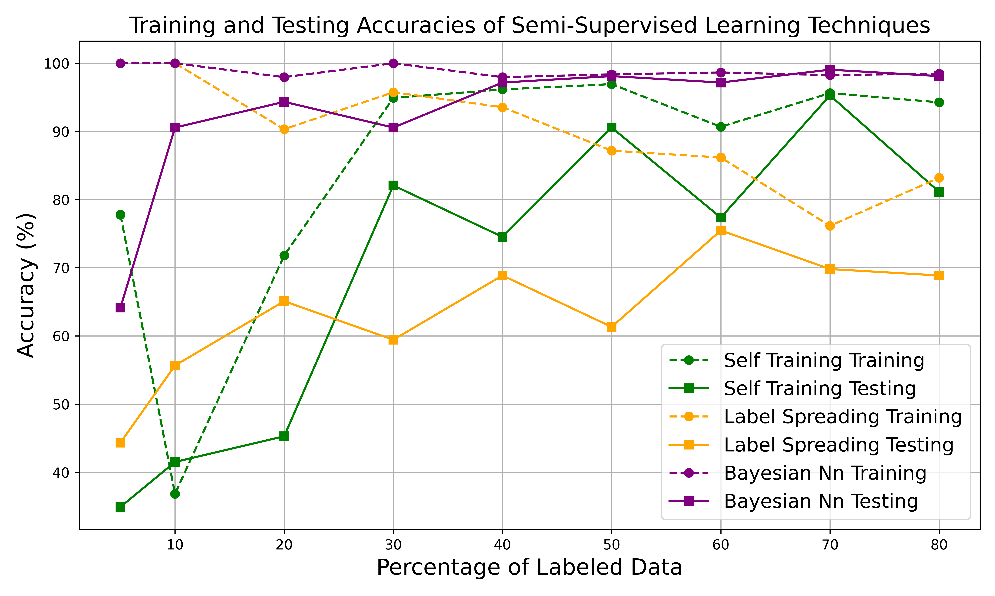
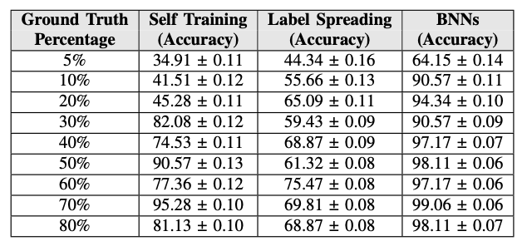
Results
Conclusion
The semi-supervised learning framework combined with Bayesian Neural Networks enables accurate phase identification using AMI data.
The proposed approach effectively utilizes limited and noisy labeled data, achieving up to 99% accuracy with just 50–70% labeled samples.
By incorporating epistemic and aleatoric uncertainty estimation, the framework not only improves prediction performance but also offers confidence-aware decisions, which are critical in power system operations.
Fig. 5: Comparison of different SSL algorithms.
TABLE I: Results of SSL Algorithms With Uncertainty Estimation.

